Slide 1

Sprocket Central Pty Ltd
Data analytics approach

Slide 2
Agenda
The approach will be implemented in three stages :
Data Exploration
Model Development
Interpretation

Slide 3
Agenda
Approach for New Customer Data analysis :
Age distribution and Bike purchase
Job industry
Wealth Segment
Number of cars owned

Slide 4
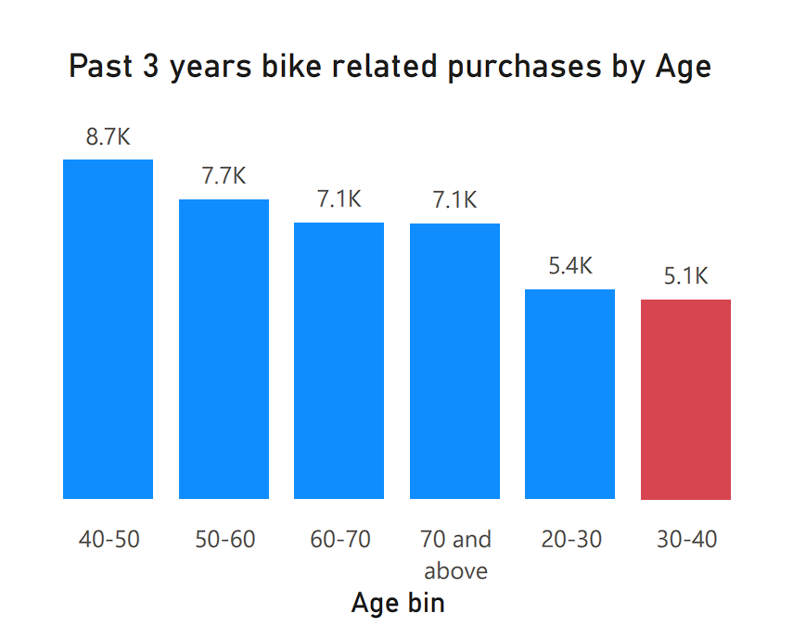
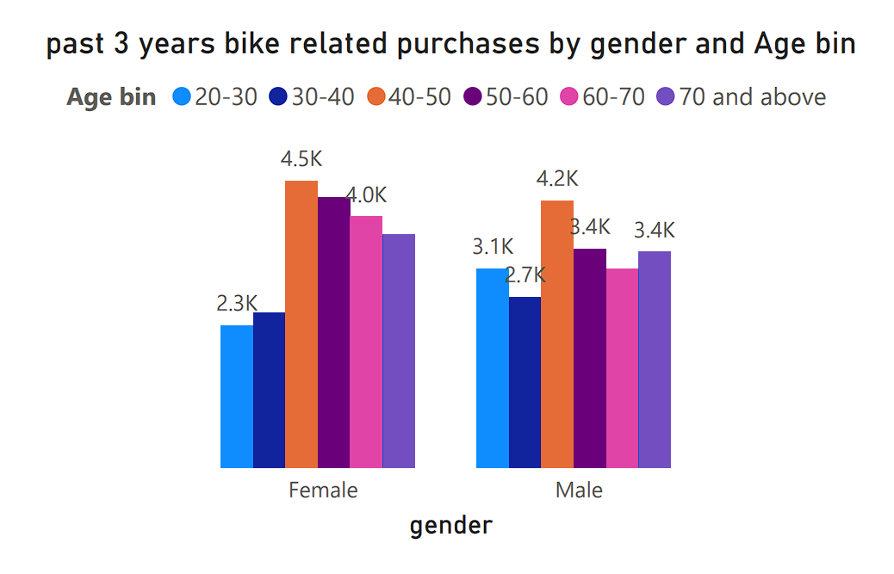
Data Exploration : Age Distribution & Bike Purchases
New customers are more from the age group of 40-50 , followed by 50-60 & 60-70.
Fewer customer are from 30-40 & 20-30.
Data shows age group 40-50 has high count in terms of bike purchased in last 3 years with a slightly greater female ratio.
The target audience for our marketing and advertising should be inclined to provide focus on females than males.

Slide 5
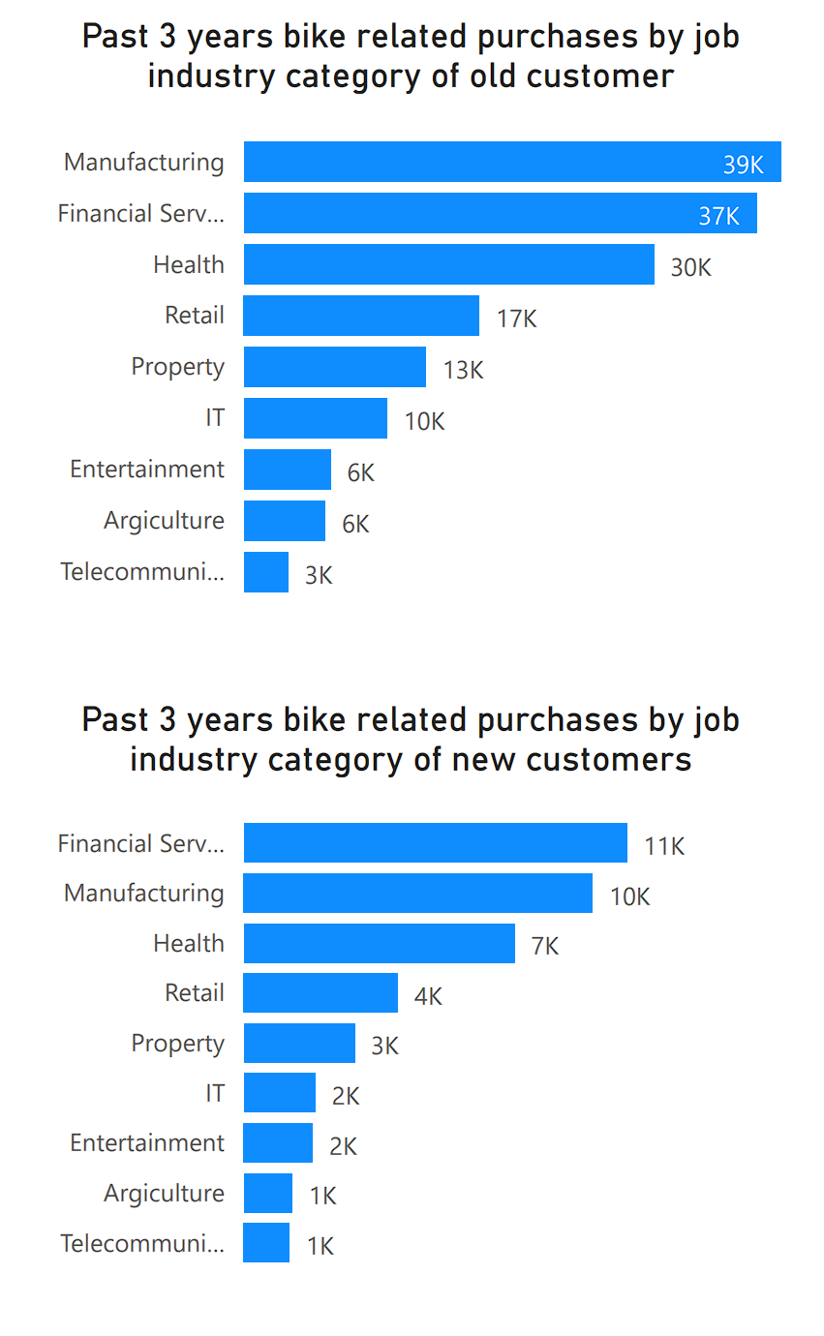
Data Exploration : Job Industry
Manufacturing, Financial Services, and Health are the top three profit-generating industries, followed by retail and property in the past 3 years for old Customers.
Whereas, The highest profits are seen in Financial Services, Manufacturing, and Health, followed by retail and property in the past 3 years for new Customers.

Slide 6
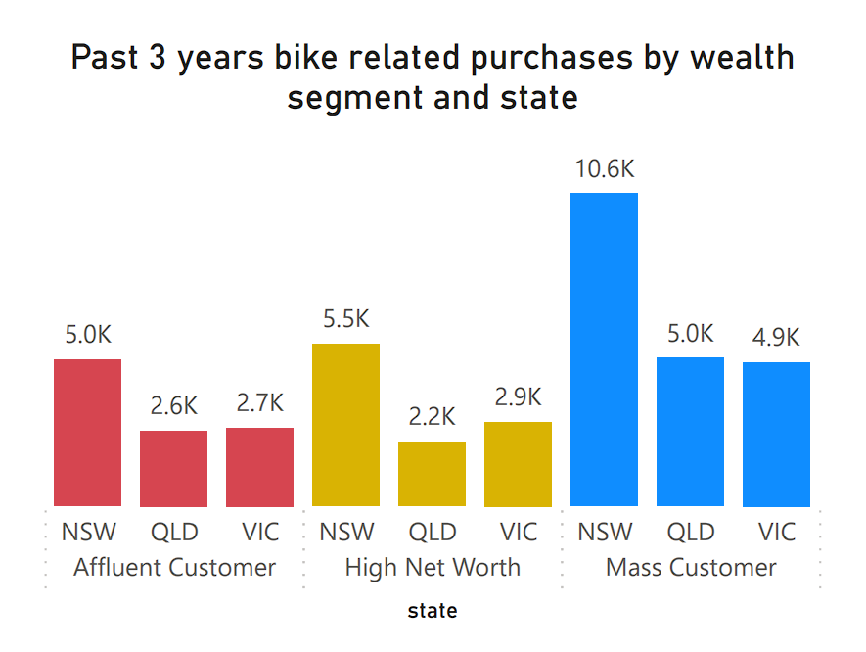
Data Exploration : Wealth segment
New South Wales state has observed greater purchasing activity across all wealth segments, including Affluent Customers, High Net Worth individuals, and Mass Customers, with a particularly notable increase in purchases among Mass Customers.
While Queensland and Victoria have witnessed fewer and comparable purchases across all wealth segments, including Affluent Customers, High Net Worth individuals, and Mass Customers

Slide 7
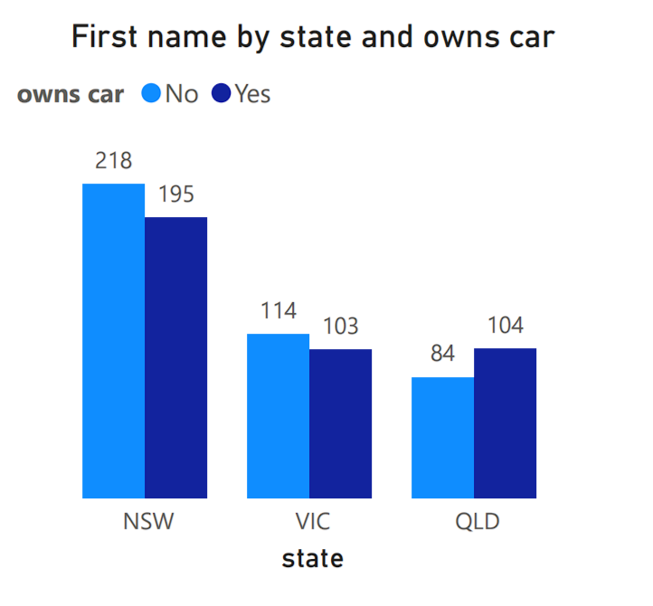
Data Exploration : Number of cars owned
Out of three states, New South Wales, could be potential market opportunities for the company.
New South Wales has the biggest potential since the number of people who own vehicles is nearly equal to the number of individuals who do not own cars, indicating that there is room for value customers there.
VIC and QLD has more customers that own car that who don’t but we can try to have something so that those owns car will buy bikes.

Slide 8
Model Development
CUSTOMER CLASSIFICATION – Targeting High Value Customers
The following are the high-value clients to target from the new list :
Aged between 40 – 50.
Most of the high value customers are female compared to male
Working in Financial Service, Manufacturing and Health.
Who are currently living in New South Wales and Victoria.

Slide 9
Interpretation
Potential Insights:
Explore why females are more prevalent among high-value customers. Is it due to specific product preferences, marketing approaches, or socioeconomic factors?
Investigate further into why certain industries yield more high-value customers. Are there particular needs or pain points within these industries that your products or services address effectively?
Consider delving deeper into the demographics and behaviors of customers in New South Wales and Victoria to understand their specific preferences and habits, enabling more targeted and effective marketing campaigns.
Interpreting these insights can help in refining marketing strategies, tailoring products and services, and allocating resources more effectively to attract and retain high-value customers.

Slide 10
Note: The data and information in this document is reflective of a hypothetical situation and client. This document is to be used for KPMG Virtual Internship purposes only.
THANK YOU

